Slide 1

Introduction to algorithms
Seminar 6
w/c:8 November 2021

Slide 2
Insertion sort: [left hand] , [right hand]
Sort this list using insertion sort: [9,0,7,8,4,6,2]
9 | 0 | 7 | 8 | 4 | 6 | 2
9 | 0 | 7 | 8 | 4 | 6 | 2
Left Hand
Right Hand

Slide 3
Insertion sort: [left hand] , [right hand]
Sort this list using insertion sort: [9,0,7,8,4,6,2]
9 | 0 | 7 | 8 | 4 | 6 | 2
 | 0 | 7 | 8 | 4 | 6 | 2
Left Hand
Right Hand
9

Slide 4
Insertion sort: [left hand] , [right hand]
Sort this list using insertion sort: [9,0,7,8,4,6,2]
9 | 0 | 7 | 8 | 4 | 6 | 2
 |  | 7 | 8 | 4 | 6 | 2
Left Hand
Right Hand
0 | 9

Slide 5
Insertion sort: [left hand] , [right hand]
Sort this list using insertion sort: [9,0,7,8,4,6,2]
9 | 0 | 7 | 8 | 4 | 6 | 2
 |  |  | 8 | 4 | 6 | 2
Left Hand
Right Hand
0 | 7 | 9

Slide 6
Insertion sort: [left hand] , [right hand]
Sort this list using insertion sort: [9,0,7,8,4,6,2]
9 | 0 | 7 | 8 | 4 | 6 | 2
 |  |  |  | 4 | 6 | 2
Left Hand
Right Hand
0 | 7 | 8 | 9

Slide 7
Insertion sort: [left hand] , [right hand]
Sort this list using insertion sort: [9,0,7,8,4,6,2]
9 | 0 | 7 | 8 | 4 | 6 | 2
 |  |  |  |  | 6 | 2
Left Hand
Right Hand
0 | 4 | 7 | 8 | 9

Slide 8
Insertion sort: [left hand] , [right hand]
Sort this list using insertion sort: [9,0,7,8,4,6,2]
9 | 0 | 7 | 8 | 4 | 6 | 2
 |  |  |  |  |  | 2
Left Hand
Right Hand
0 | 4 | 6 | 7 | 8 | 9

Slide 9
Insertion sort: [left hand] , [right hand]
Sort this list using insertion sort: [9,0,7,8,4,6,2]
9 | 0 | 7 | 8 | 4 | 6 | 2
Left Hand
Right Hand
0 | 2 | 4 | 6 | 7 | 8 | 9
Sorted!!

Slide 10
Insertion sort components
Insertion Sort has two components:
Make Comparisons (sort)
Then
Insert elements in the right place

Slide 11
Insert an element into a sorted list
Suppose we have a sorted list:
10 | 20 | 44 | 60 | 70 | 80
Now, let’s INSERT 50
50 > 10
50 > 20
50 > 44
50 < 60
10 | 20 | 44 | 60 | 70 | 80

Slide 12
Insert an element into a sorted list
Suppose we have a sorted list:
10 | 20 | 44 | 60 | 70 | 80
Now, let’s INSERT 50
Comparison:
50 > 10
50 > 20
50 > 44
50 < 60
10 | 20 | 44 | 50 | 60 | 70 | 80
element in the right place!!

Slide 13
Insert (Algorithm)
Algorithm: insert(x,sortedList)
Requires: a sorted list and an element x
Returns: a sorted list with element x in the right place
1. if isEmpty(sortedList) then
2. return cons(x,sortedList) //base case 1
3. elseif x<head(sortedList) then
4. return cons(x,sortedList) //base case 2
5. else
6. return cons(head(sortedList),insert(x,tail(sortedList)))//recursive call
7. endif

Slide 14
Insert (Algorithm) - trace
Algorithm: insert(x,sortedList)
Requires: a sorted list and an element x
Returns: a sorted list with element x in the right place
1. if isEmpty(sortedList) then
2. return cons(x,sortedList) //base case 1
3. elseif x<head(sortedList) then
4. return cons(x,sortedList) //base case 2
5. else
6. return cons(head(sortedList),insert(x,tail(sortedList)))//recursive call
7. endif
insert(14,[7,11,16,20])
sortedList=[7,11,16,20])
x=14
14<head(sortedList)?
NO
cons(7,insert(14,[11,16,20]))
Backtracking!
insert(14,[11,16,20])
sortedList=[11,16,20])
x=14
14<head(sortedList)?
NO
cons(11,insert(14,[16,20]))
insert(14,[16,20])
sortedList=[16,20])
x=14
14<head(sortedList)?
YES
cons(14,[16,20])
=[14,16,20]
Base case

Slide 15
Insert (Algorithm) - trace
Algorithm: insert(x,sortedList)
Requires: a sorted list and an element x
Returns: a sorted list with element x in the right place
1. if isEmpty(sortedList) then
2. return cons(x,sortedList) //base case 1
3. elseif x<head(sortedList) then
4. return cons(x,sortedList) //base case 2
5. else
6. return cons(head(sortedList),insert(x,tail(sortedList)))//recursive call
7. endif
insert(14,[7,11,16,20])
sortedList=[7,11,16,20])
x=14
14<head(sortedList)?
NO
cons(7,insert(14,[11,16,20]))
Backtracking!
x=14
14<head(sortedList)?
NO
cons(11,[14,16,20])
=[11,14,16,20]
x=14
14<head(sortedList)?
YES
cons(14,[16,20])
=[14,16,20]
Base case

Slide 16
Insert (Algorithm) - trace
Algorithm: insert(x,sortedList)
Requires: a sorted list and an element x
Returns: a sorted list with element x in the right place
1. if isEmpty(sortedList) then
2. return cons(x,sortedList) //base case 1
3. elseif x<head(sortedList) then
4. return cons(x,sortedList) //base case 2
5. else
6. return cons(head(sortedList),insert(x,tail(sortedList)))//recursive call
7. endif
insert(14,[7,11,16,20])
sortedList=[7,11,16,20])
x=14
14<head(sortedList)?
NO
cons(7,[11,14,16,20])
=[7,11,14,16,20]
END
Backtracking!
x=14
14<head(sortedList)?
NO
cons(11,[14,16,20])
=[11,14,16,20]
x=14
14<head(sortedList)?
YES
cons(14,[16,20])
=[14,16,20]
Base case

Slide 17
Insertion sort algorithm
(main)
Algorithm: insertionSort(list)
Requires: a list of numbers
Returns: a sorted list of numbers in ascending order
Algorithm: insert(x,sortedList)
Requires: a sorted list and an element x
Returns: a sorted list with element x in the right place
1. return sortHelper(list,[])
1. if isEmpty(sortedList) then
2. return cons(x,sortedList)
3. elseif x<head(sortedList) then
4. return cons(x,sortedList)
5. else
6. return cons(head(sortedList),insert(x,tail(sortedList)))
7. endif
Algorithm: sortHelper(leftList,rightList)
Requires: two lists
Returns: rightList, sorted version of leftList
(helper function)
1. if isEmpty(leftList) then
2. return rightList //base case
4. else
5. return sortHelper(tail(leftList),insert(head(leftList),rightList))//recursive call
6. endif
Trace for insertionSort([10,8,9,16,4,7])

Slide 18
Homework: which one is the worst case for insertion sort?
[1,2,3,4,5,6]
[6,5,4,3,2,1]

Slide 19
Merge-sort: three algorithms!
SPLIT
SORT
MERGE

Slide 20
What is the natural way of splitting a list into two?
L=[9,8,5,3,1,0,2,4]
Find the midpoint of the list
L1=[9,8,5,3] L2=[1,0,2,4]

Slide 21
What is the natural way of splitting a list into two?
L=[9,8,5,3,1,0,2,4,6]
Find the midpoint of the list
L1=[9,8,5,3] L2=[1,0,2,4,6]

Slide 22
Split algorithm
Algorithm: split(list)
Requires: a list
Returns: two lists containing half the elements of input list
Do we need helper function?
We need an extra list!!

Slide 23
Split algorithm
(main)
Algorithm: split(list)
Requires: a list
Returns: two lists containing half the elements of input list
1. Let m=length(list)/2 //middle of list
2. if m==0 then
3. return list //single or empty list
4. else
5. return splitHelper(list,[],m)//helper function
6. endif
(helper function)
Algorithm: splitHelper(list1,list2,n)
Requires: two lists and a positive integer n
Returns: two lists, list1 and list2
Moving elements from list1 to list2
1. if n==0 then
2. return (list1,list2) //base case
3. else
4. return splitHelper(tail(list1),cons(head(list1),list2),n-1) //recursive call
5. endif

Slide 24

Merge-sort: three algorithms!
SPLIT
SORT
MERGE

Slide 25
Merging two sorted lists
0 | 2 | 4 | 9
1 | 5 | 6 | 8

Slide 26
Merging two sorted lists
0 | 2 | 4 | 9
1 | 5 | 6 | 8

Slide 27
Merging two sorted lists
 | 2 | 4 | 9
1 | 5 | 6 | 8
0

Slide 28
Merging two sorted lists
 | 2 | 4 | 9
1 | 5 | 6 | 8
0

Slide 29
Merging two sorted lists
 | 2 | 4 | 9
 | 5 | 6 | 8
0 | 1

Slide 30
Merging two sorted lists
 |  | 4 | 9
 | 5 | 6 | 8
0 | 1 | 2

Slide 31
Merging two sorted lists
 |  |  | 9
 | 5 | 6 | 8
0 | 1 | 2 | 4

Slide 32
Merging two sorted lists
 |  |  | 9
 |  | 6 | 8
0 | 1 | 2 | 4 | 5

Slide 33
Merging two sorted lists
 |  |  | 9
 |  |  | 8
0 | 1 | 2 | 4 | 5 | 6

Slide 34
Merging two sorted lists
 |  |  | 9
0 | 1 | 2 | 4 | 5 | 6 | 8

Slide 35
Merging two sorted lists
0 | 1 | 2 | 4 | 5 | 6 | 8 | 9
merge(sortedList1,sortedList2)=longerSortedList

Slide 36
Merge algorithm
Algorithm: merge(list1,list2)
Requires: two sorted lists
Returns: a longer (merged) sorted list
1. if isEmpty(list1) then
2. return list2 //base case
3. elseif isEmpty(list2) then
4. return list1 //base case
5. elseif head(list1)<head(list2) then
return cons(head(list1),merge(tail(list1),list2))
else //head(list2)<head(list1)
return cons(head(list2),merge(list1,tail(list2)))
endif
Trace for merge([10,20,30],[1,15,40,55])

Slide 37
Merge-sort: three algorithms!
SPLIT
SORT
MERGE

Slide 38
Mergesort algorithm
Algorithm: mergeSort(list)
Requires: a list
Returns: a sorted list
Algorithm: split(list)
Requires: a list
Returns: two lists containing half the elements of input list
if isEmpty(list) || isEmpty(tail(list)) then
return list //base case (list is already sorted)
else
let(L1,L2)=split(list) //splitting list
let S1=mergeSort(L1) //sorting (recursive call)
let S2=mergesort(L2) //sorting (recursive call)
return merge(S1,S2) // merging
endif
Algorithm: merge(list1,list2)
Requires: two sorted lists
Returns: a longer (merged) sorted list

Slide 39
demonstration
Algorithm: mergeSort(list)
Requires: a list
Returns: a sorted list
if isEmpty(list) || isEmpty(tail(list)) then
return list //base case
else
let(L1,L2)=split(list) //splitting list
let S1=mergeSort(L1) //sorting (recursive call)
let S2=mergesort(L2) //sorting (recursive call)
return merge(S1,S2) // merging
endif
[0,9,2,4,3,6]
L1=[0,9,2] L2=[4,3,6]
split
recursive call:
S1=mergeSort([0,9,2]) S2=mergeSort([4,3,6])
L1=[0] L2=[9,2]
L1=[4,3] L2=[6]
split
recursive call:
S1=mergeSort([0]) S2=mergeSort([9,2])
S1=mergeSort([4,3]) S2=mergeSort([6])
[0]
L1=[9] L2=[2]
L1=[4] L2=[3]
split
[6]
recursive call:
S1=mergeSort([9]) S2=mergeSort([2])
S1=mergeSort([4]) S2=mergeSort([3])
Base case
[9]
[2]
[4]
[3]

Slide 40
demonstration
Algorithm: mergeSort(list)
Requires: a list
Returns: a sorted list
if isEmpty(list) || isEmpty(tail(list)) then
return list //base case
else
let(L1,L2)=split(list) //splitting list
let S1=mergeSort(L1) //sorting (recursive call)
let S2=mergesort(L2) //sorting (recursive call)
return merge(S1,S2) // merging
endif
[0,9,2,4,3,6]
L1=[0,9,2] L2=[4,3,6]
L1=[0] L2=[9,2]
L1=[4,3] L2=[6]
[0]
L1=[9] L2=[2]
L1=[4] L2=[3]
[6]
merge([9],[2])=[2,9]
merge([4],[3])=[3,4]
[9]
[2]
[4]
[3]

Slide 41
demonstration
Algorithm: mergeSort(list)
Requires: a list
Returns: a sorted list
if isEmpty(list) || isEmpty(tail(list)) then
return list //base case
else
let(L1,L2)=split(list) //splitting list
let S1=mergeSort(L1) //sorting (recursive call)
let S2=mergesort(L2) //sorting (recursive call)
return merge(S1,S2) // merging
endif
[0,9,2,4,3,6]
L1=[0,9,2] L2=[4,3,6]
L1=[0] L2=[9,2]
L1=[4,3] L2=[6]
merge([0],[2,9])=[0,2,9]
merge([3,4],[6])=[3,4,6]
[0]
[2,9]
[3,4]
[6]
merge([9],[2])=[2,9]
merge([4],[3])=[3,4]
[9]
[2]
[4]
[3]

Slide 42
demonstration
Algorithm: mergeSort(list)
Requires: a list
Returns: a sorted list
if isEmpty(list) || isEmpty(tail(list)) then
return list //base case
else
let(L1,L2)=split(list) //splitting list
let S1=mergeSort(L1) //sorting (recursive call)
let S2=mergesort(L2) //sorting (recursive call)
return merge(S1,S2) // merging
endif
[0,9,2,4,3,6]
L1=[0,9,2] L2=[4,3,6]
merge([0,2,9],[3,4,6])
[0,2,9]
[3,4,6]
merge([0],[2,9])=[0,2,9]
merge([3,4],[6])=[3,4,6]
[0]
[2,9]
[3,4]
[6]
merge([9],[2])=[2,9]
merge([4],[3])=[3,4]
[9]
[2]
[4]
[3]

Slide 43
demonstration
Algorithm: mergeSort(list)
Requires: a list
Returns: a sorted list
if isEmpty(list) || isEmpty(tail(list)) then
return list //base case
else
let(L1,L2)=split(list) //splitting list
let S1=mergeSort(L1) //sorting (recursive call)
let S2=mergesort(L2) //sorting (recursive call)
return merge(S1,S2) // merging
endif
[0,9,2,4,3,6]
[0,2,3,4,6,9]
merge([0,2,9],[3,4,6])
[0,2,9]
[3,4,6]
merge([0],[2,9])=[0,2,9]
merge([3,4],[6])=[3,4,6]
[0]
[2,9]
[3,4]
[6]
merge([9],[2])=[2,9]
merge([4],[3])=[3,4]
[9]
[2]
[4]
[3]

Slide 44
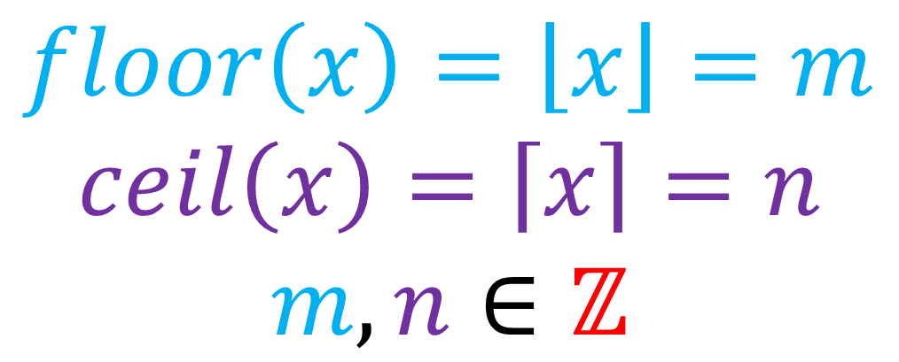
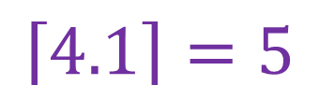
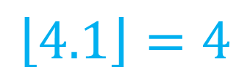
Time complexity
$$floor\left(x\right)=\left\lfloor \left.x\right\rfloor =m\right.$$
$$ceil\left(x\right)=\left\lceil \left.x\right\rceil =n\right.$$
$$m,n∈ℤ$$
$$x−1<m≤x≤n<x+1$$
$$\left\lfloor \left.4.1\right\rfloor =4\right.$$
$$\left\lceil \left.4.1\right\rceil =5\right.$$

Slide 45
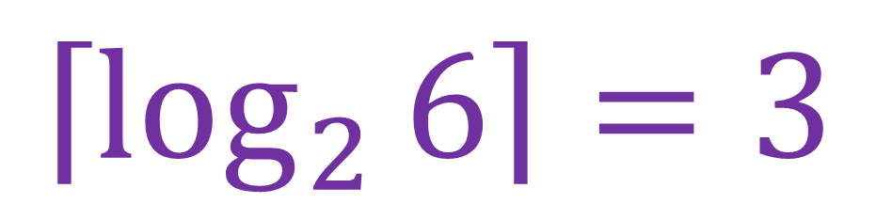
demonstration
[0,9,2,4,3,6]
split
L1=[0,9,2] L2=[4,3,6]
split
L1=[0] L2=[9,2]
L1=[4,3] L2=[6]
split
L1=[9] L2=[2]
L1=[4] L2=[3]
$$\left\lceil \left.\log_{2}{6}\right\rceil =3\right.$$

Slide 46


Time complexity
$$(\left\lceil 6.\left.\log_{2}{6}\right\rceil )=16\right.$$
operations
$$O(\left\lceil n\left.\log_{2}{n}\right\rceil )\right.$$

